Slide 1
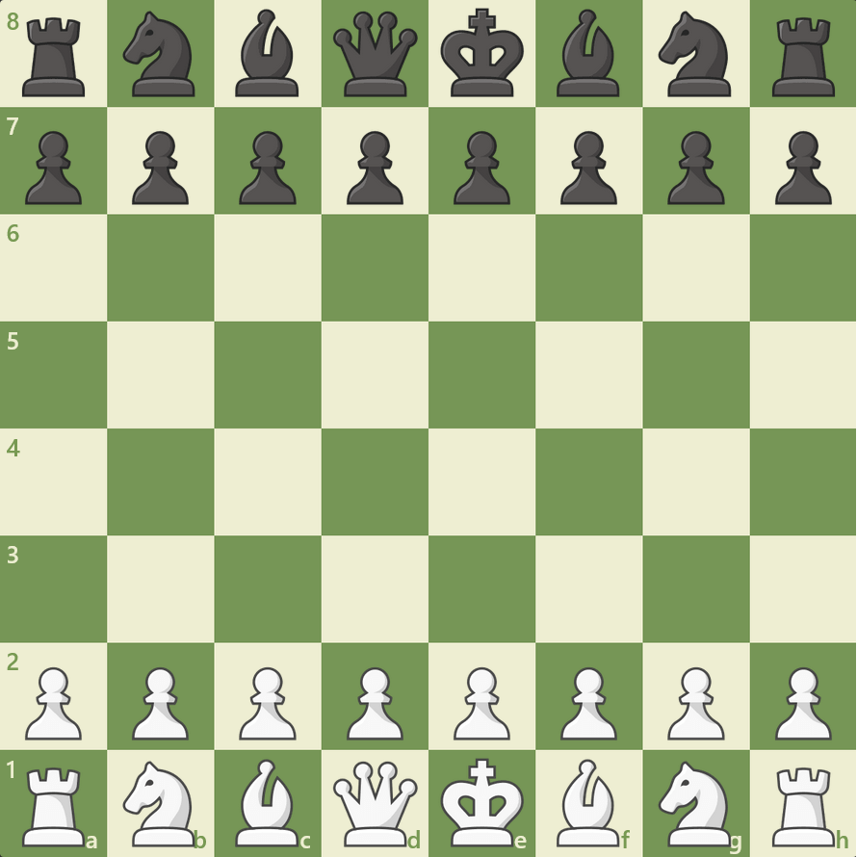
Chess!
Lukas, Spencer

Slide 2
Algorithm, Tools, and Notation
Algorithm
Tools
Notation
Minimax with alpha-beta pruning.
Depth limit is required
Other considered algorithm was Monte Carlo Search
“chesslib” library (maven dependency)
Create board objects
Apply moves
Many built in helper methods
User input is in SAN notation
Square to square coordinates
Ex: a3b4, move from square a3 to b4

Slide 3
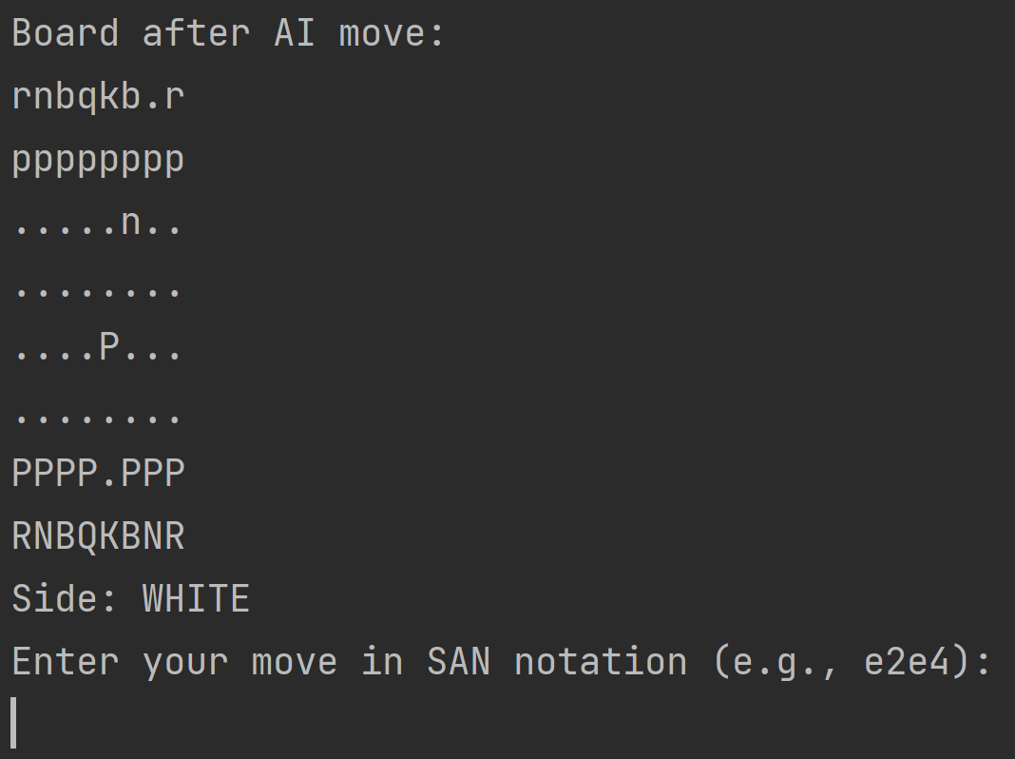
It works!
max growth
Minimax with alpha-beta pruning greatly reduces computation time!

Slide 4
Problems (a few of them)
Chess is hard
Evaluating Moves
Making the choice
Chess is not a solved game.
Our AI is not very good at chess.
Take into account :
Piece values
Piece coordination
Centralization
Offensive or defensive moves
The sheer amount of moves
Many more
Many moves have the same or similar evaluation but result in massively different boards.

Slide 5
Main Heuristics
Piece Values
Prioritize Center
Captures
PAWN: 100
KNIGHT: 320
BISHOP: 330
ROOK:500
QUEEN: 900
KING: 10000
Used in many places, helps keep material on the board.
The center of the board is a much stronger position than the outsides
Inner 4 square have large bonus value, next closest 12 squares have small bonus value
Using piece values, have a heavy bonus value depending on the piece captured.

Slide 6
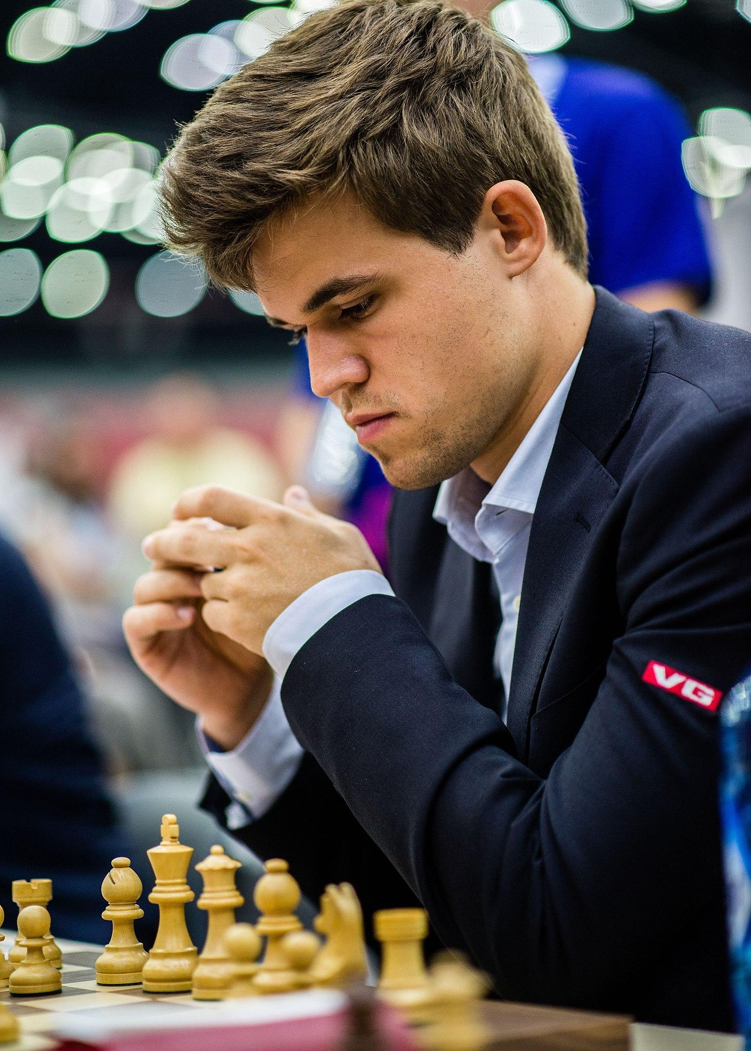
Quick Overview
max owth
Rewrote Minimax for chess application
Applied and tested many heuristics
A lot of bug fixing

